Slide 1

Capstone Project - 4
Book Recommendation System
Individual Project
Name:- Subham Behera
Email:- subhambehera924@gmail.com

Slide 2
Content
Problem statement
Data Summary
Analysis of different datasets
Data Cleaning
Outlier treatment
Imputing missing values
Different Recommendation Model
Challenges
Conclusion
Future Scope

Slide 3

Problem Statement
During the last few decades,with the rise of Youtube, Amazon, Netflix, and many other such web services, recommender systems have become much more important in our lives in terms of providing highly personalized and relevant content.
The main objective is to create a recommendation system to recommend relevant books to users based on popularity and user interests.

Slide 4
Data Summary
1. The dataset is comprised of three csv files:: 1) users 2) books 3) ratings
Users_dataset
Books_dataset
User-ID(unique for each user)
Location (contains city, state and country separated by commas)
Age
ISBN (unique for each book)
Book-Title
Book-Author
Year-Of-Publication
Publisher
Image-URL-S
Image-URL-M
Image-URL-L
Shape of Dataset- (278858,3)
Ratings_dataset
User-ID
ISBN
Book-Rating
Shape of Dataset - (271360,8)
Shape of Dataset -(1149780,3)

Slide 5
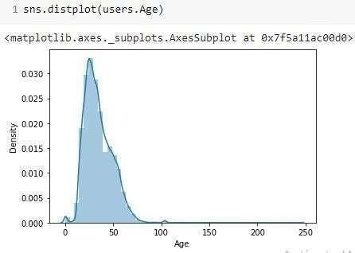
Observations from "Users" dataset(Age)
The Age range given here is from 0 to 250.
Outliers are in the Age column.

Slide 6
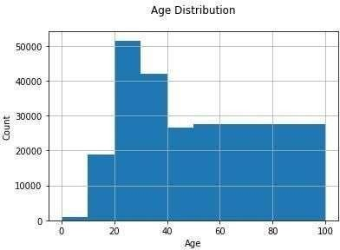
Here is the AGE DISTRIBUTION graph and we found that-
The Age range distribution is right skewed
Most active readers lie in
age group 20-40

Slide 7
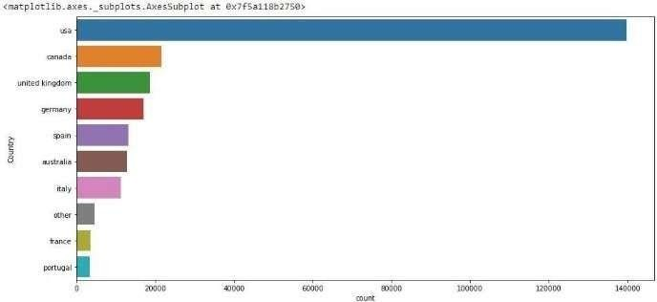
Here we are Splitting Location column and analyzing country and found that-
The most active readers are from USA.

Slide 8
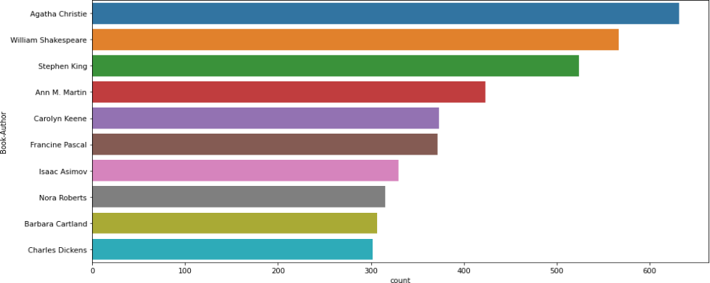
Observations from “books” dataset(Authors)
Agatha Christie wrote highest number of books in our given dataset

Slide 9
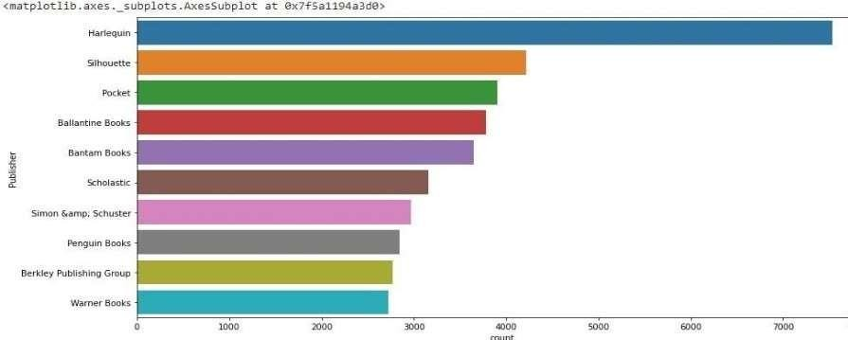
Observations from “books” dataset(Publishers)
Harlequin published highest number of books in our given dataset.

Slide 10
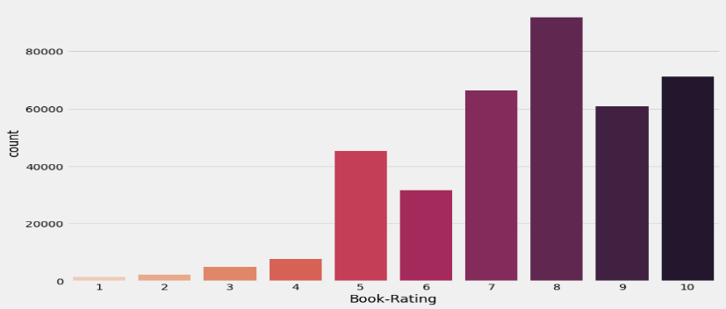
Observations from "Ratings" dataset
Higher ratings are more common amongst users
Rating 8 has been rated the highest number of times

Slide 11
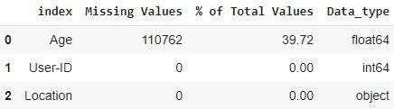
Data Cleaning from “users” dataset
1. Null Value Imputation:
Age column has 40% of missing values

Slide 12

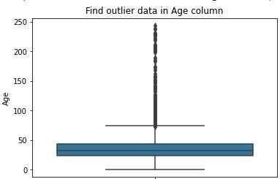
Imputing missing values
As we know that the outliers are in Age column and
Age has positive Skewness (right tail) so we can use median to fill Nan values

Slide 13
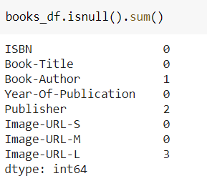
Data Cleaning from “books” dataset
1. Null Value Imputation:

Slide 14
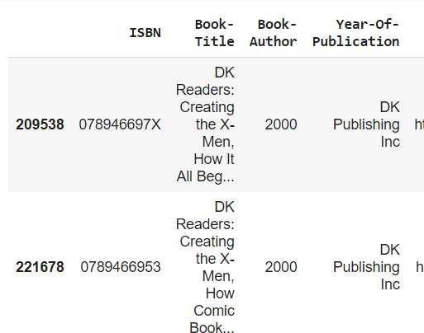
Replacing strings by int values

Slide 15
Different Models
1) Popularity Based Recommendation
Book weighted average formula:
Weighted Rating(WR) = [vR/(v+m)]+[mC/(v+m)]
Where,
V is the number of votes for the books;
m is the minimum votes required to be listed in the chart
R is the average rating of the book and
C is the mean vote across the whole report.

Slide 16
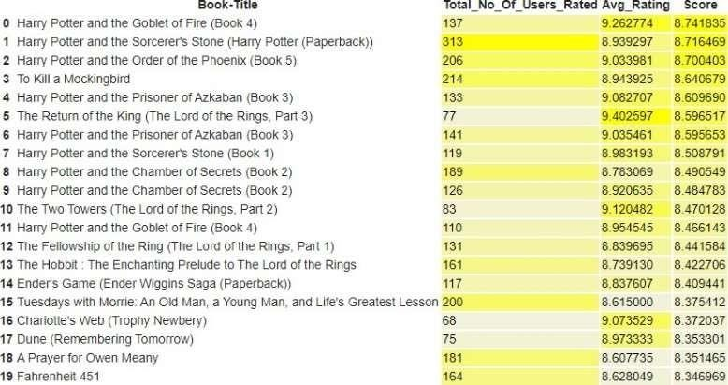
Different Models

Slide 17
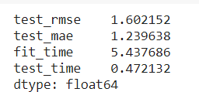
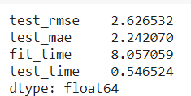
Different Models
2) Model based collaborative filtering
SVD
NMF

Slide 18


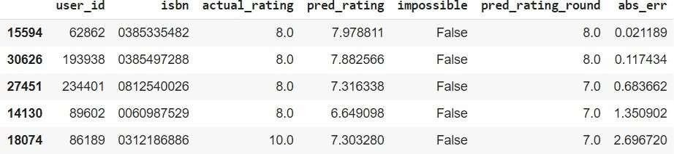
Different Models

Slide 19

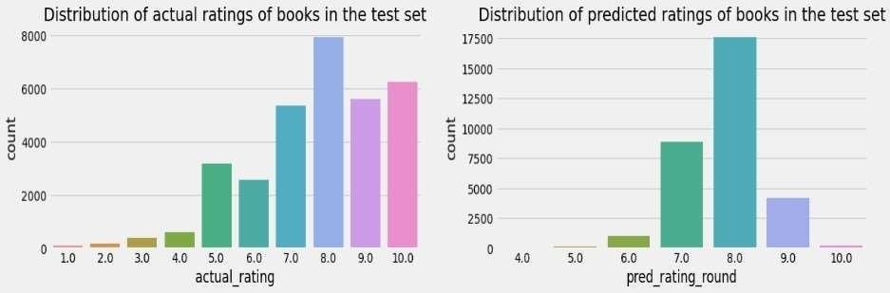
Different Models

Slide 20
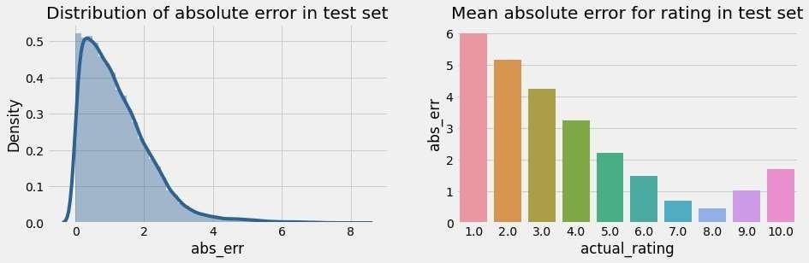
Different Models

Slide 21






Different Models

Slide 22






Different Models

Slide 23
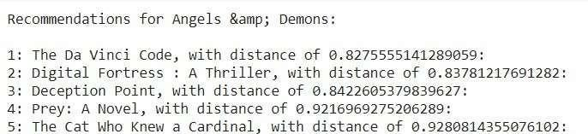
Collaborative Filtering-(Item-Item based)
3.) Collaborative Filtering-(Item-Item based)
Cosine Similarity
Nearest Neighbour

Slide 24


Different Models
SVD & Correlation
Recommendations for Harry Potter and the Sorcerer's Stone(Book 1)
Input
Output

Slide 25
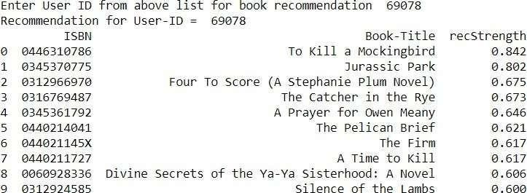
Different Models
4) Collaborative Filtering-(User-Item-based)

Slide 26
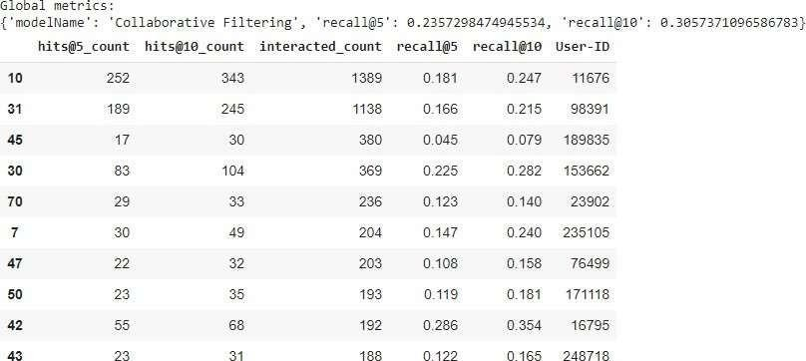
Different Models
Model Results

Slide 27
Conclusion
In EDA, the Top-10 most rated books were essentially novels. Books like 'The Lovely Bone' and 'The Secret Life of Bees' were very well perceived.
Majority of the readers were of the age bracket 20-35 and most of them came from North American and European countries namely USA, Canada, UK, Germany and Spain.
If we look at the ratings distribution, most of the books have high ratings with maximum books being rated 8. Ratings below 5 are few in number.
Author with the most books was Agatha Christie, William Shakespeare and Stephen King.
For modelling, it was observed that for model based collaborative filtering SVD technique worked way better than NMF with lower Mean Absolute Error (MAE) .

Slide 28
Conclusion
A recommendation system helps an organization to create loyal customers. The recommendation system today are very powerful that they can handle the new customer too who has visited the site for the first time. They recommend the products which are currently trending or highly rated and they can also recommend the products which bring maximum profit to the company.
A book recommendation system is a type of recommendation system where we have to recommend similar type of books to the reader based on his interest. The books recommendation system is used by online websites which provide ebooks like google playbooks, open library, good Read’ s, etc.

Slide 29
Challenges
Handling of sparsity was a major challenge as well since the user interactions were
Not present for the majority of the books.
Understanding the metric for evaluation was a challenge as well.
Since the data consisted of text data, data cleaning was a major challenge in features like Location etc..
Decision making on missing value imputations and outlier treatment was quite challenging as well.

Slide 30
Future Scope
Given more information regarding the books dataset, namely features like Genre, Description etc, we could implement a content-filtering based recommendation system and compare the results with the existing collaborative-filtering based system.
We would like to explore various clustering approaches for clustering the users based on Age, Location etc., and then implement voting algorithms to recommend items to the user depending on the cluster into which it belongs.

Slide 31

.

